Slide 1
24th AEEE Conference

Slide 2
Nice to meet you!
Sam de Muijnck

Slide 3
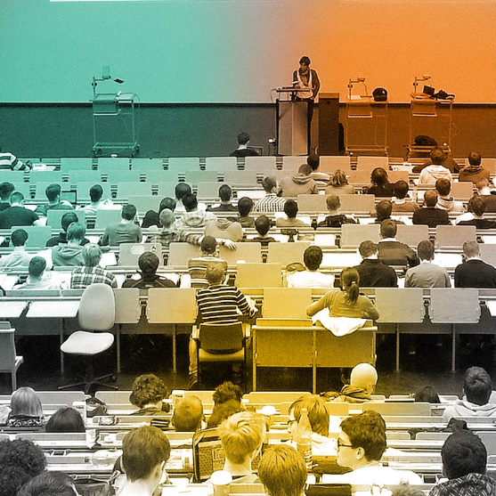
Secondary economics education
Professional business education
University economics education

Slide 4
Who are you?
In which country do you teach?
Netherlands
Other European country
A country outside of Europe

Slide 5
Who are you?
What specialisation do you teach?
Business
General economics

Slide 6
Who are you?
At what level do you teach?
In high schools / secondary education
Training high school teachers
University of applied sciences / hogeschool
Research university / universiteit

Slide 7
Overview
Economic problems
Current economics education
The movement for new economics education
Tools for change

Slide 8
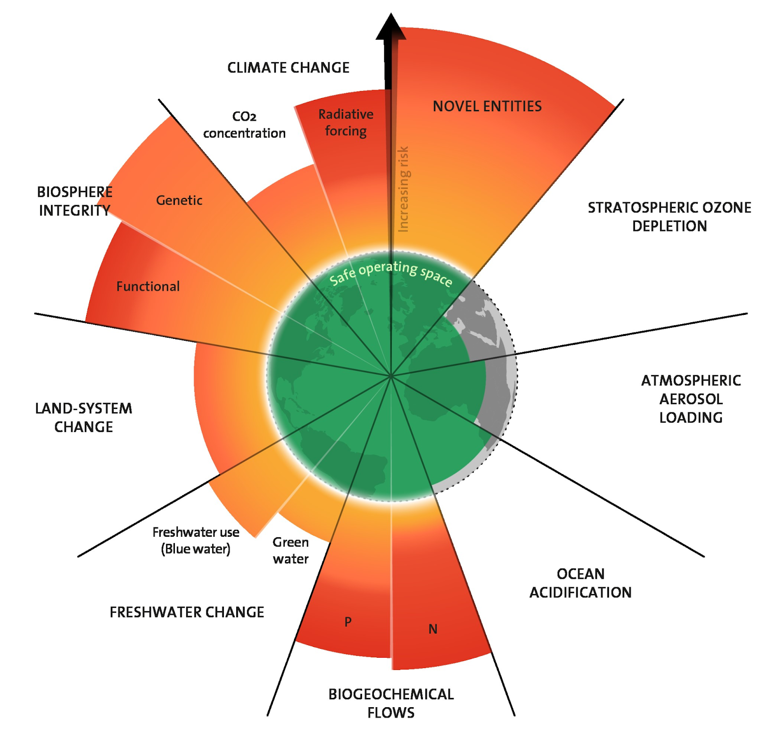
Planetary boundaries (Richardson, et al. 2023)

Slide 9
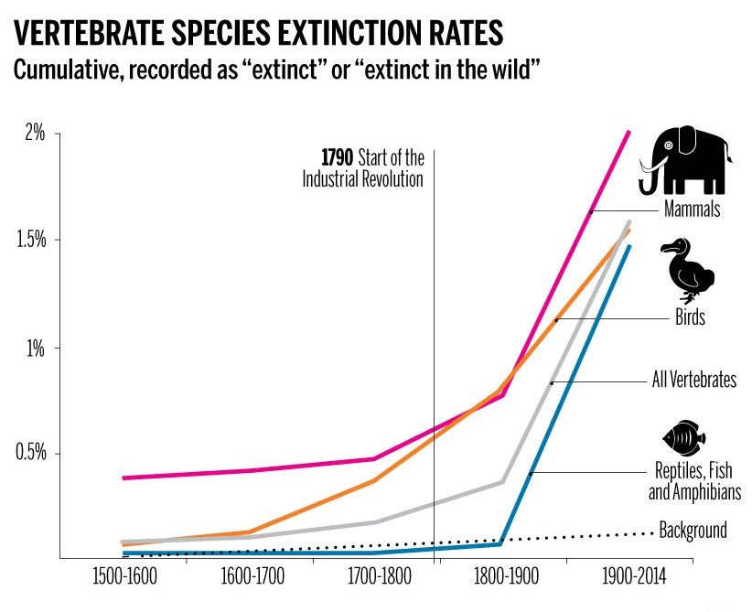
(Ceballos, et al. 2015)

Slide 10
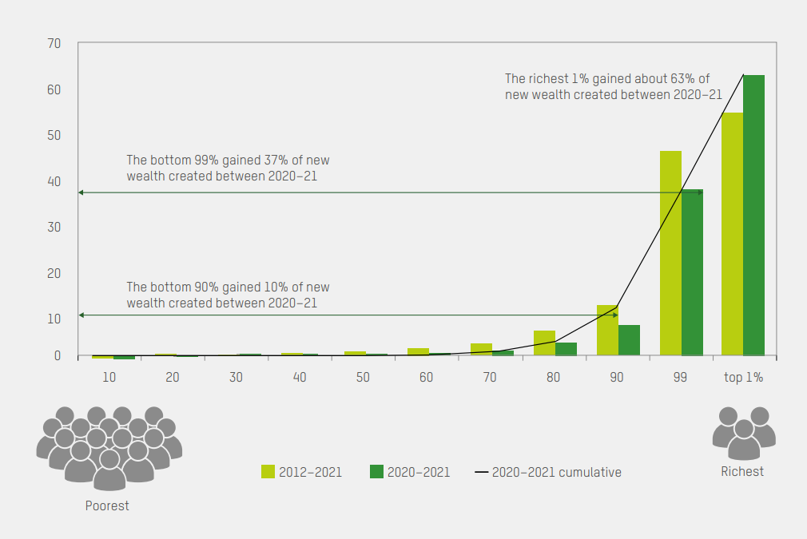
Share of new wealth gained (Oxfam 2023)

Slide 11
Current level of inequality (Oxfam 2023)
The richest 1% own almost 50% of the world’s wealth, while the poorest 50% of the world own just 0.75%.
81 billionaires have more wealth than 50% of the world combined.
A billionaire emits a million times more carbon than the average person.

Slide 12
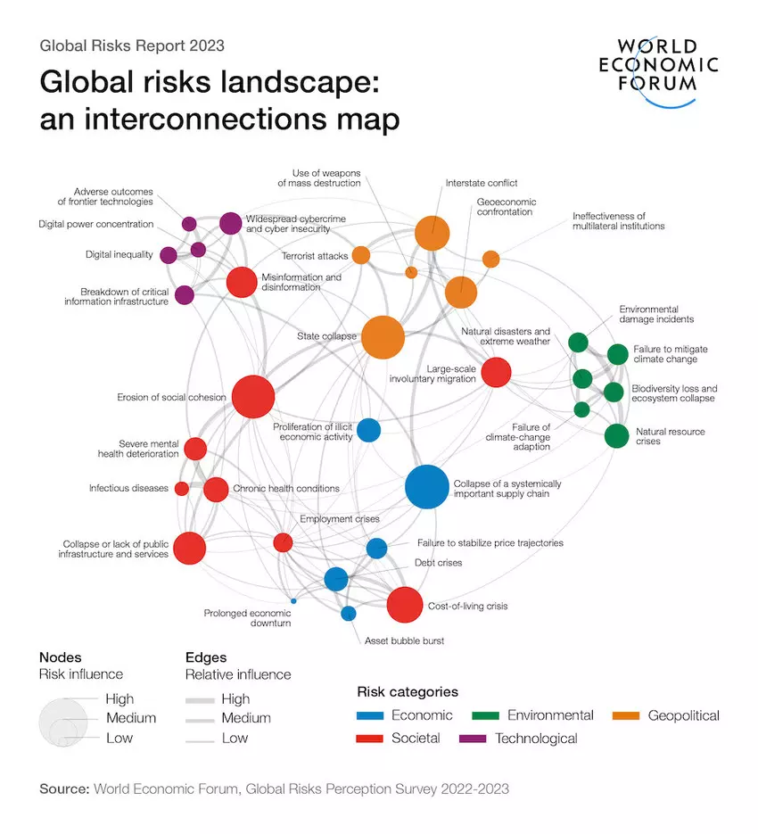

Slide 13
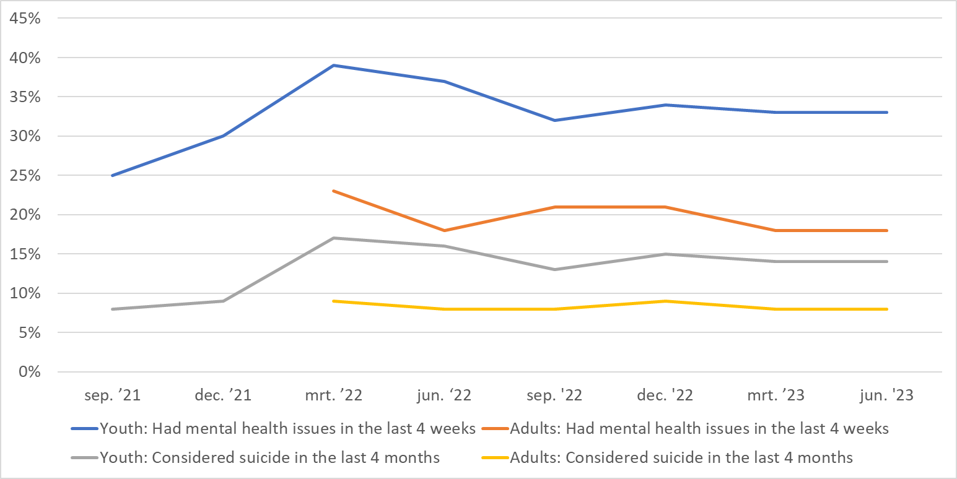

Slide 14
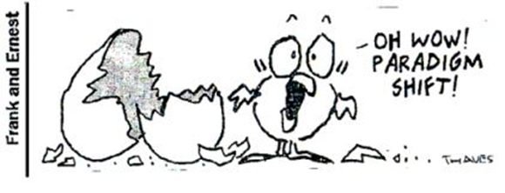
OECD: We are in a paradigm shift
1930s-1940s: Laissez-Faire Liberalism → Keynesianism
1970s-1980s: Keynesianism → Neoliberalism
2010s-present: Neoliberalism → Beyond Growth
OECD. (2020). Beyond Growth: Towards A New Economic Approach.

Slide 15
Current economics education
The influence of economics education
The origins of current economics education
The shortcomings of current economics education
The societal effects of current economics education

Slide 16
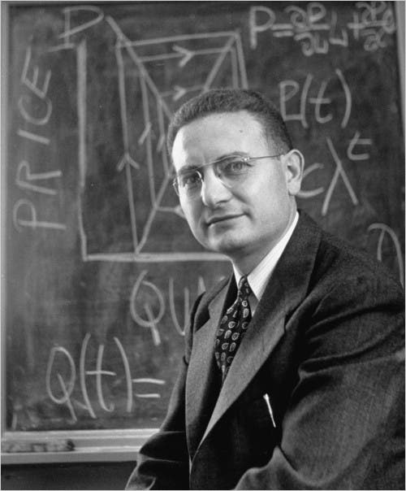
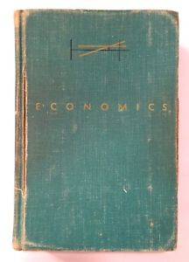
"I don't care who writes a nation's laws –
or crafts its advanced treaties –
if I can write its economics textbooks"
Paul A. Samuelson (Nasar, 1995),
author of Economics, 1948

Slide 17
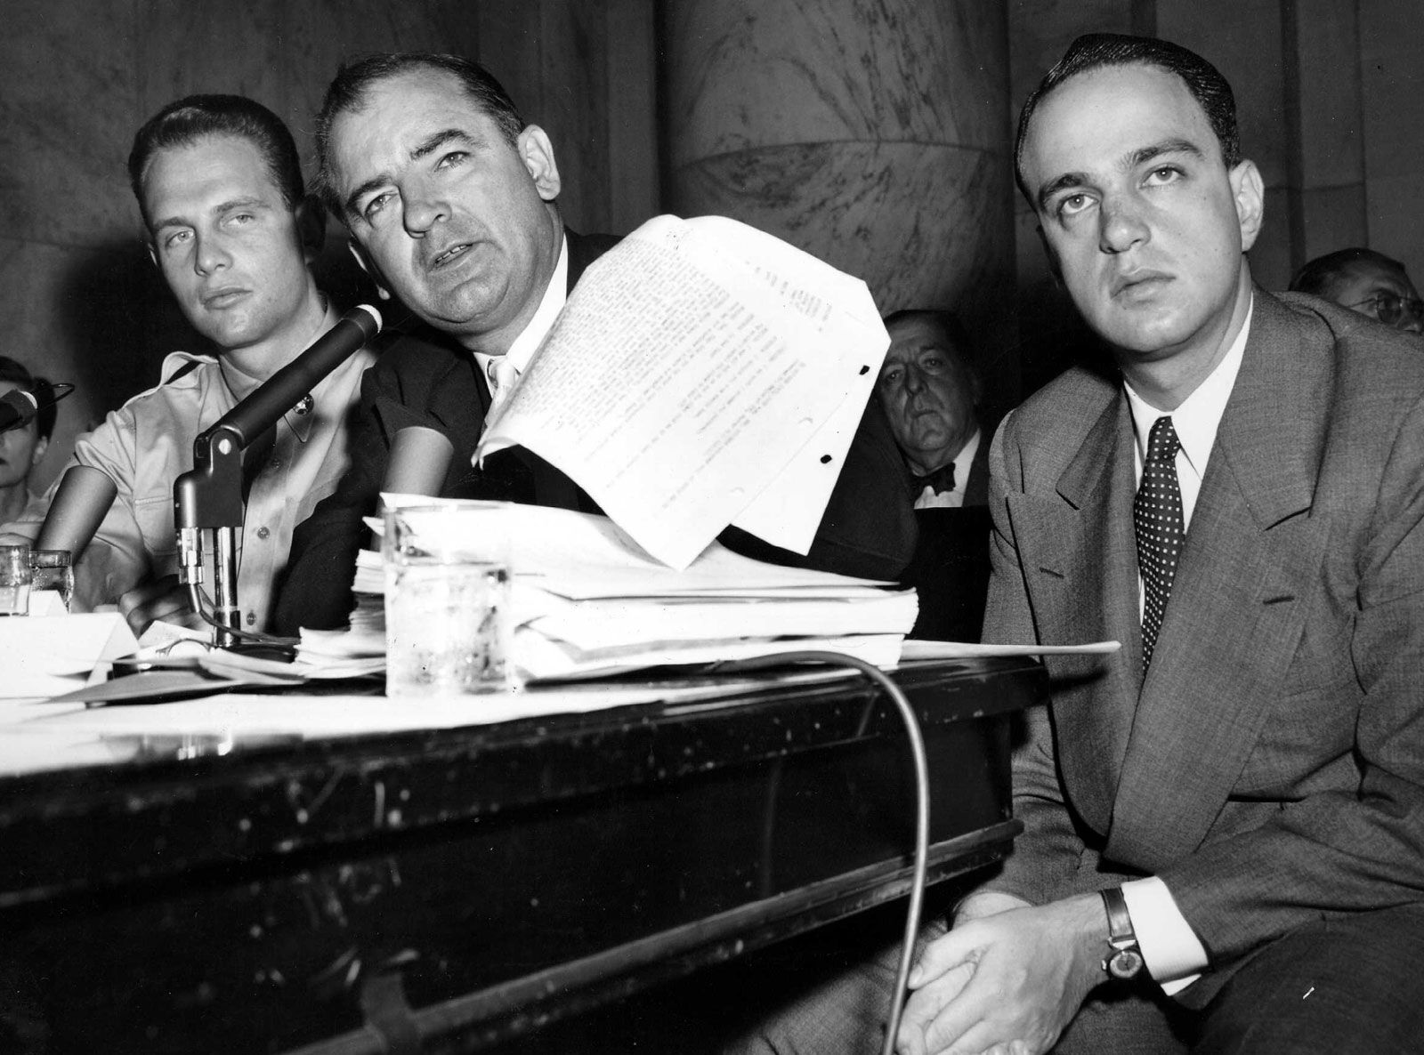

Slide 18
Some results from Netherlands

Slide 19
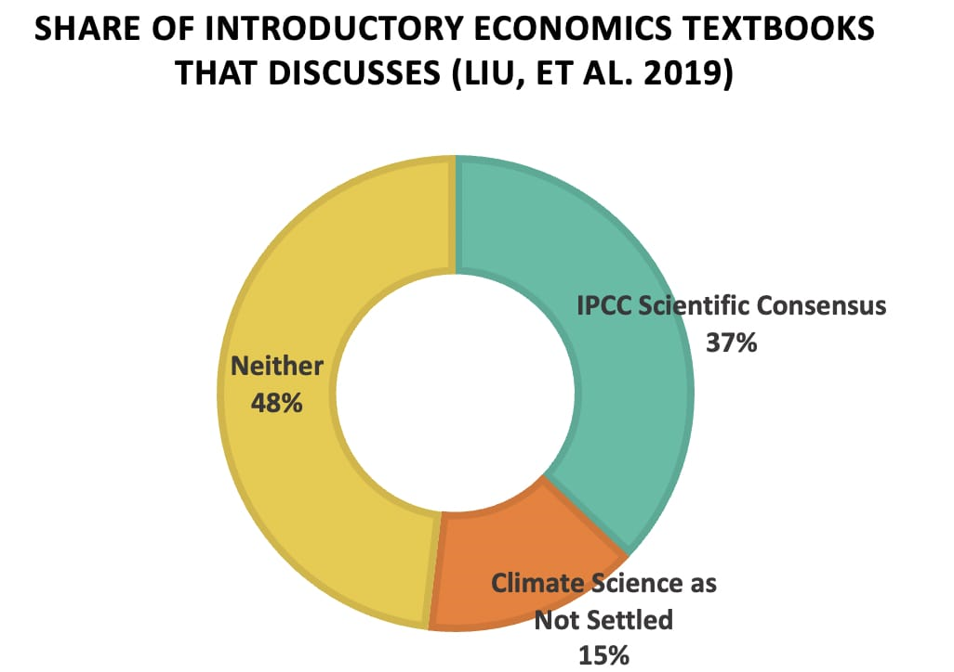

Slide 20
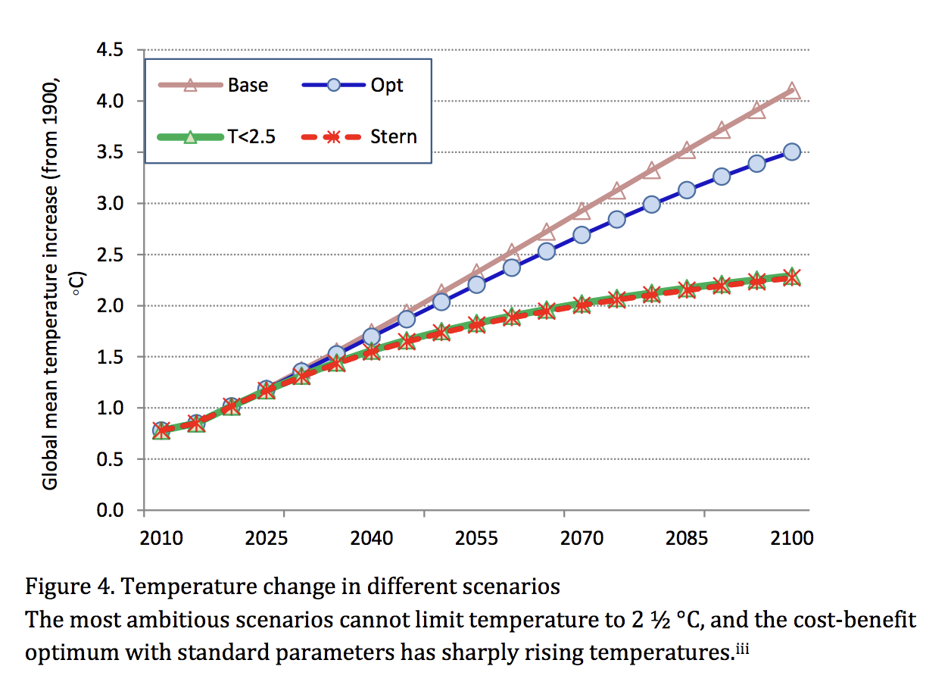
2018 “Nobel Prize” for William Nordhaus “for integrating climate change into long-run macroeconomic analysis”

Slide 22
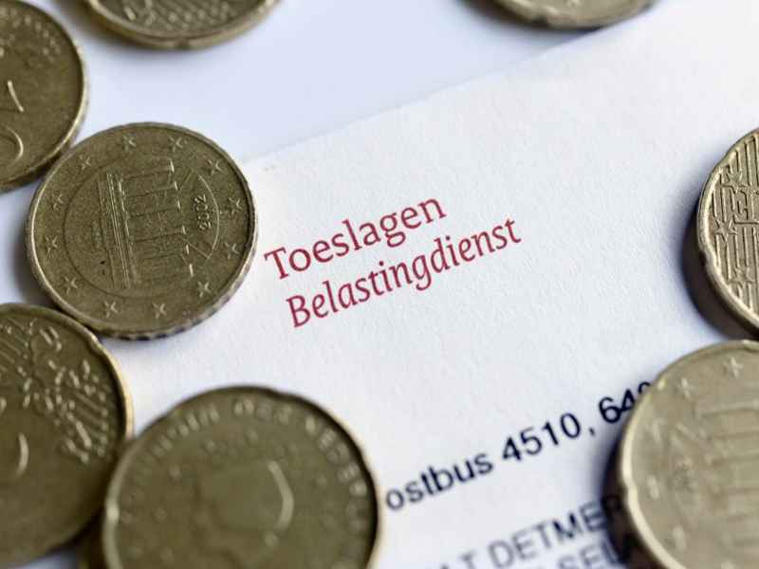

Slide 23
The movement for new economics education
The financial crisis of 2008 and resulting initiatives to reform economics education
The debate over inequality and discrimination
The growing awareness about the ecological crisis
The counter movement against reform and pluralism

Slide 24
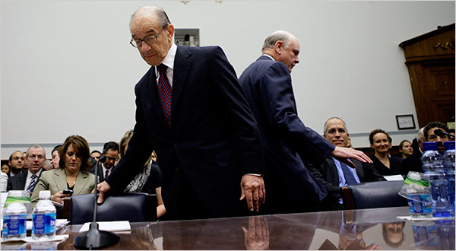
Greenspan (2008): “Flaw in the model”
Krugman (2009): “mistaking beauty for truth”

Slide 26
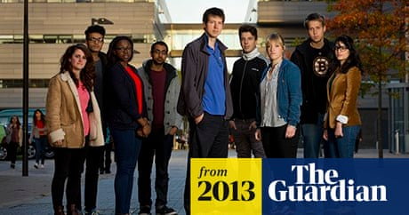

Slide 27
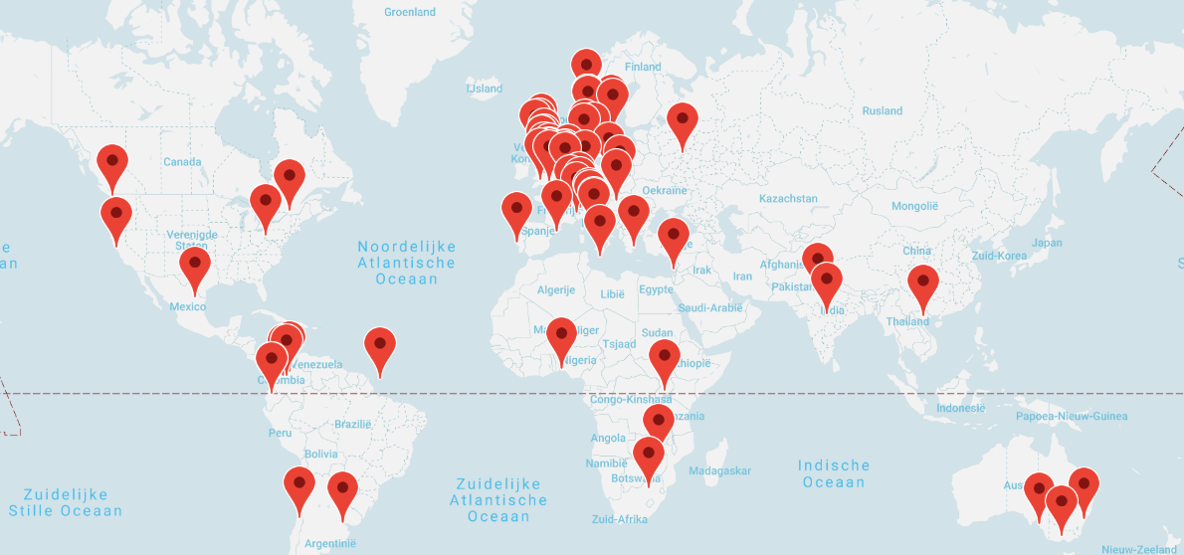

Slide 28
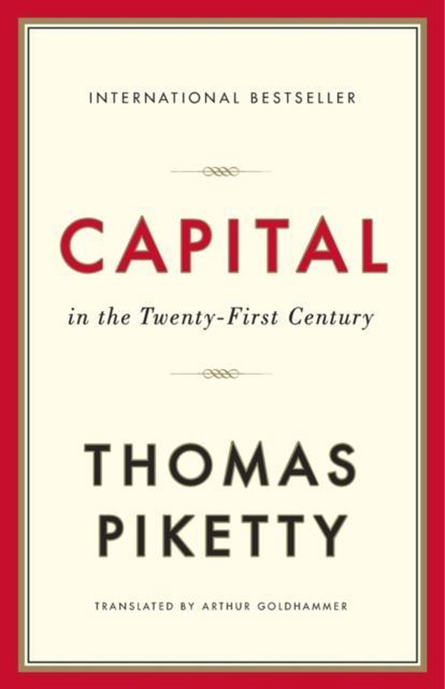
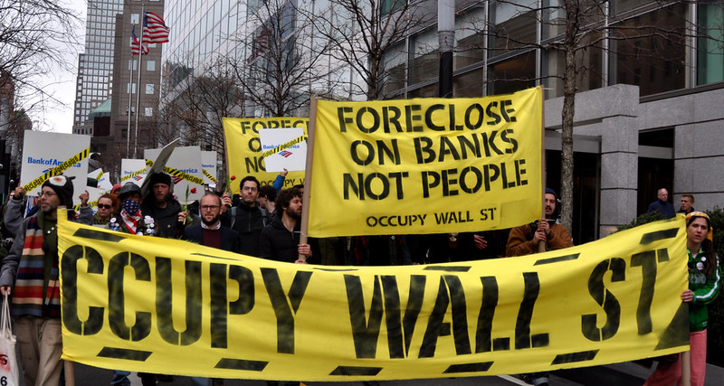
Inequality

Slide 29
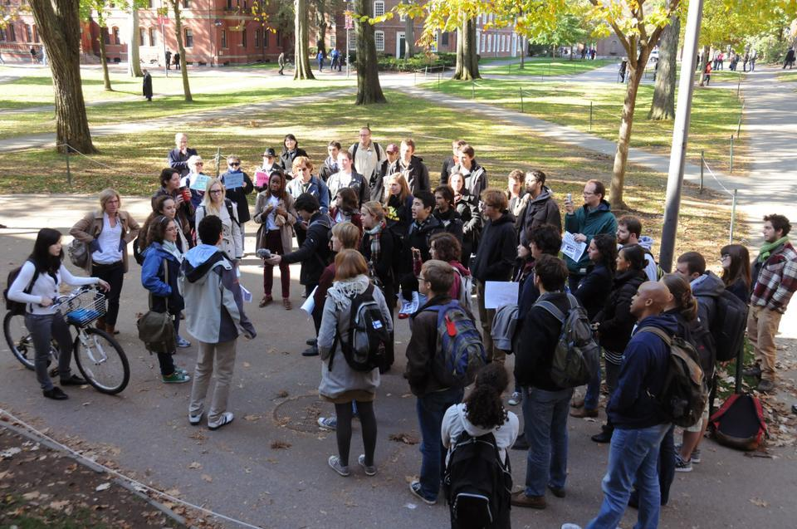
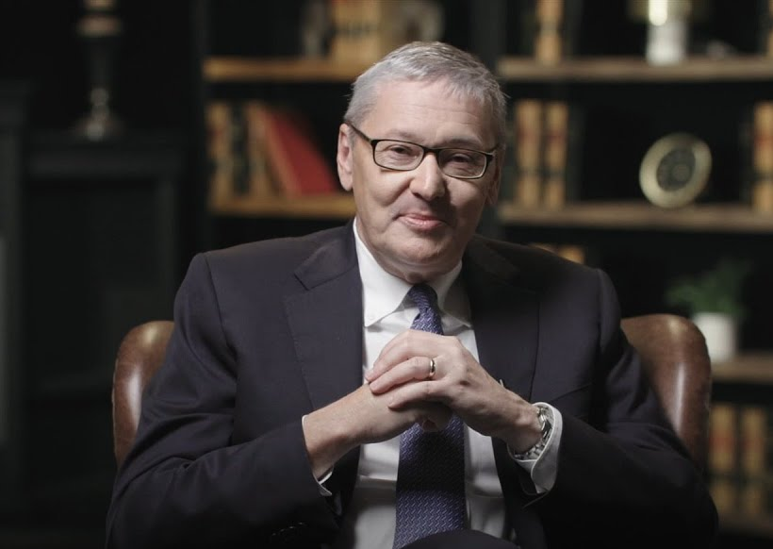
Harvard students walk out of an economics class taught by Greg Mankiw

Slide 32
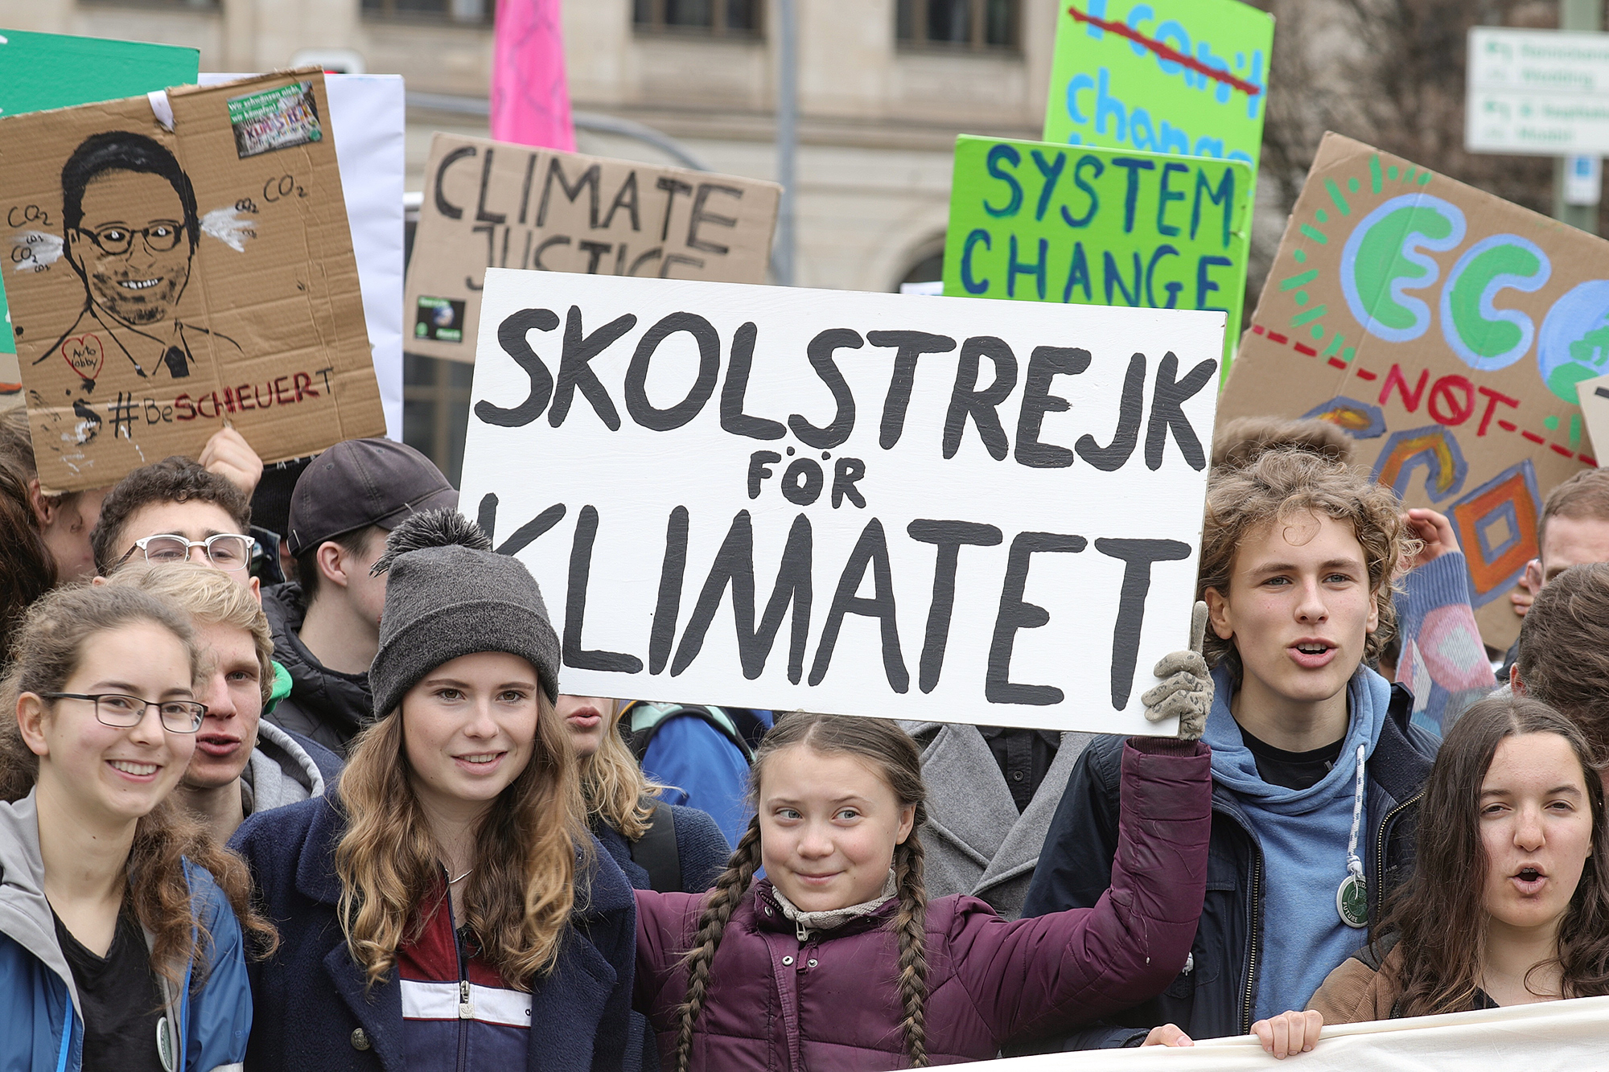
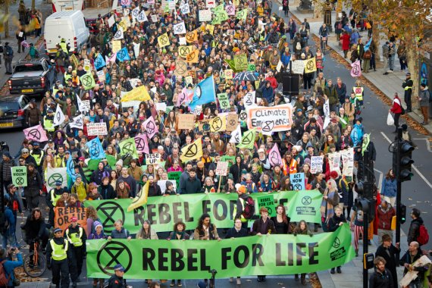

Slide 33
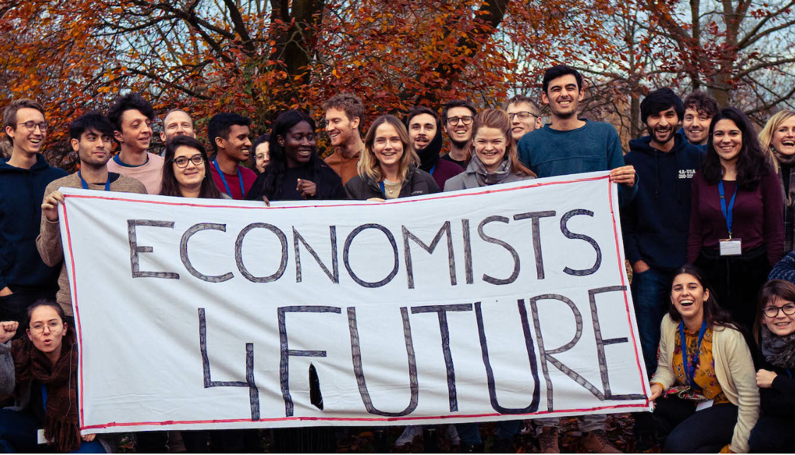

Slide 35
Mission statement: “promoting individual liberty, free-market economics, entrepreneurship, private property, high moral character, and limited government” (FEE, 2021, p. 1)

Slide 36
Tools for change
Secondary economics education
University economics education
Business education

Slide 37
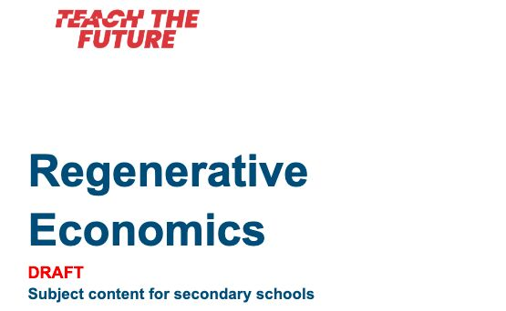
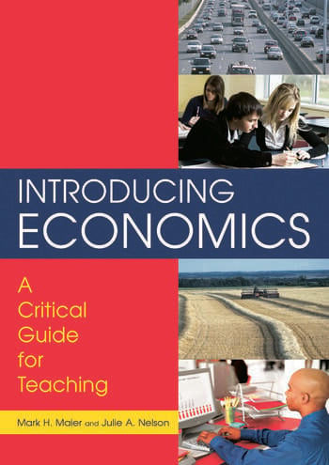
Secondary economics materials

Slide 39
Dutch materials

Slide 40
Wat is (van) Waarde? – onderbouw & bovenbouw / havo & vwo
Groei & Indicatoren – bovenbouw / havo & vwo
Hoe (zo) Circulair? – bovenbouw / havo & vwo
Echte Prijzen – bovenbouw / havo & vwo
Waardevol Werk – bovenbouw / havo & vwo
Ecologische Economie – bovenbouw / havo & vwo

Slide 42
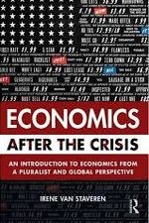
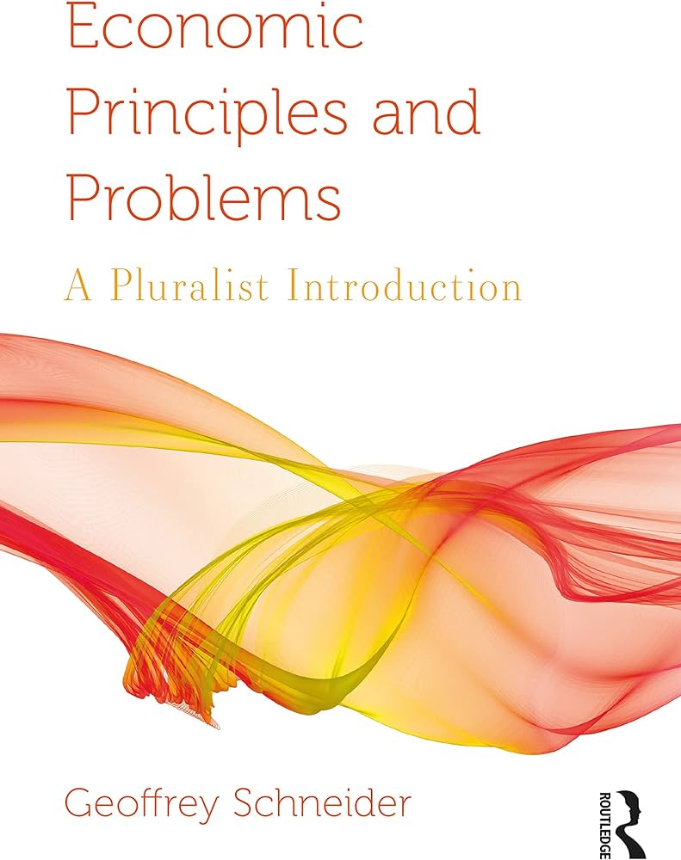
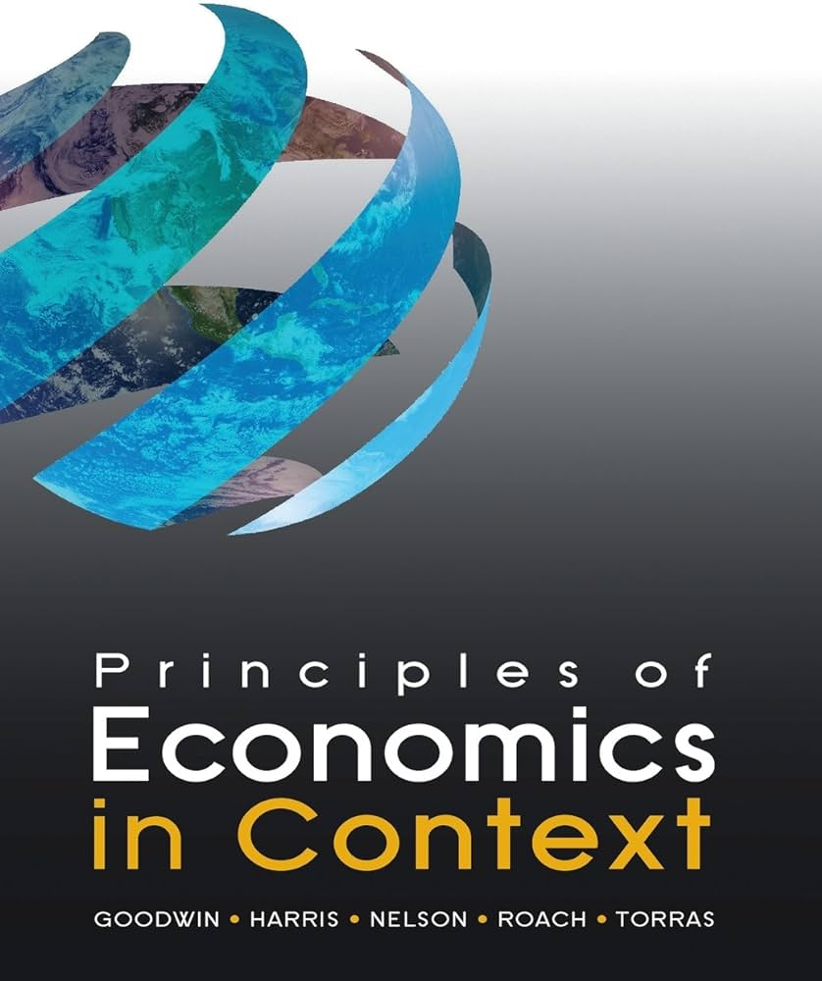
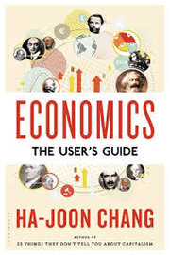
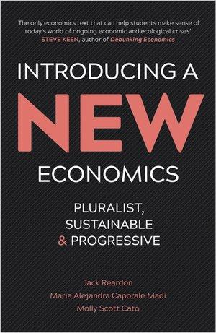
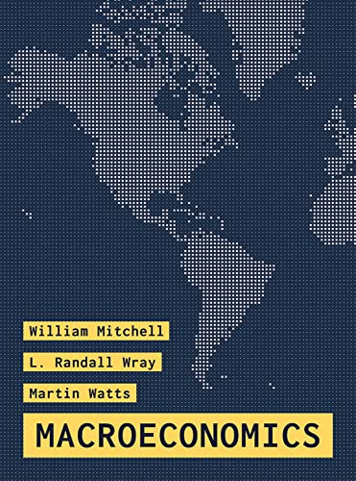
New economics textbooks

Slide 43
The CORE approach
Central aim: Samuelson’s paradigm → CORE’s paradigm
“Just as Samuelson popularized the concept of aggregate demand in an introductory text, CORE has taken information economics and strategic social interaction and made these concepts part of the foundation of an economic paradigm that introductory students can learn … We have also integrated more recent developments in the discipline from the fields of behavioural economics, economic dynamics, and institutional economics.”

Slide 44
Books with a pluralist approach

Slide 45
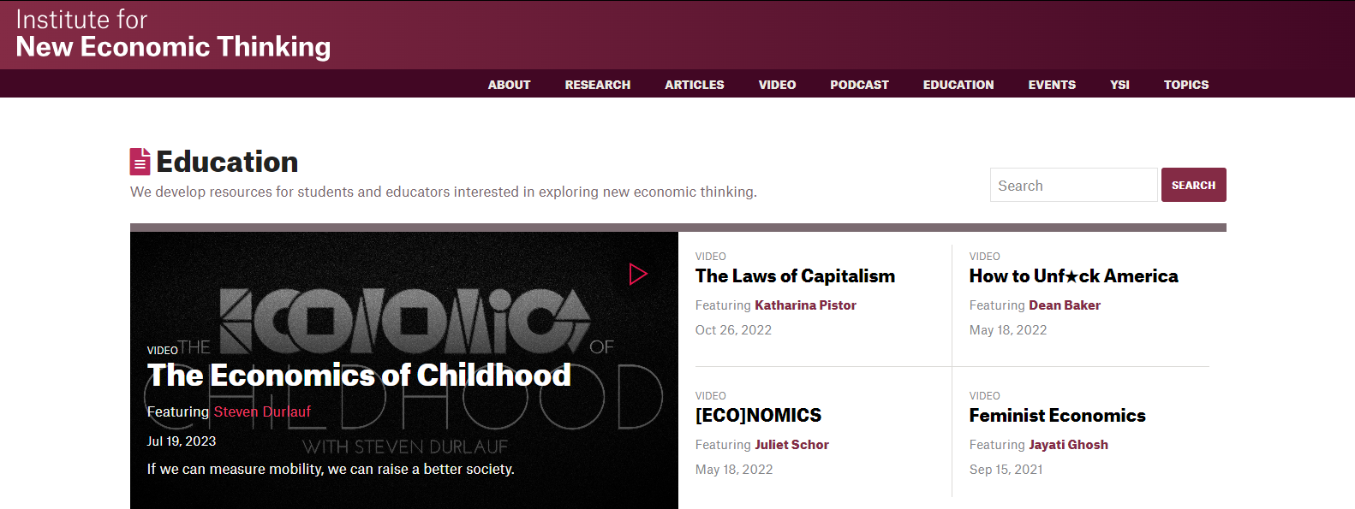
The Netflix of Economics

Slide 46
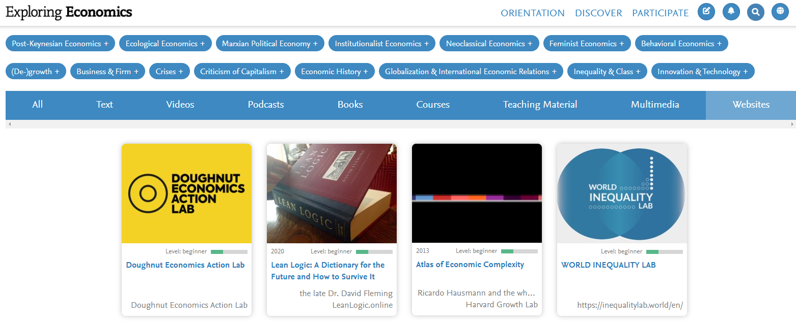
Another Online Platform for Economics

Slide 47
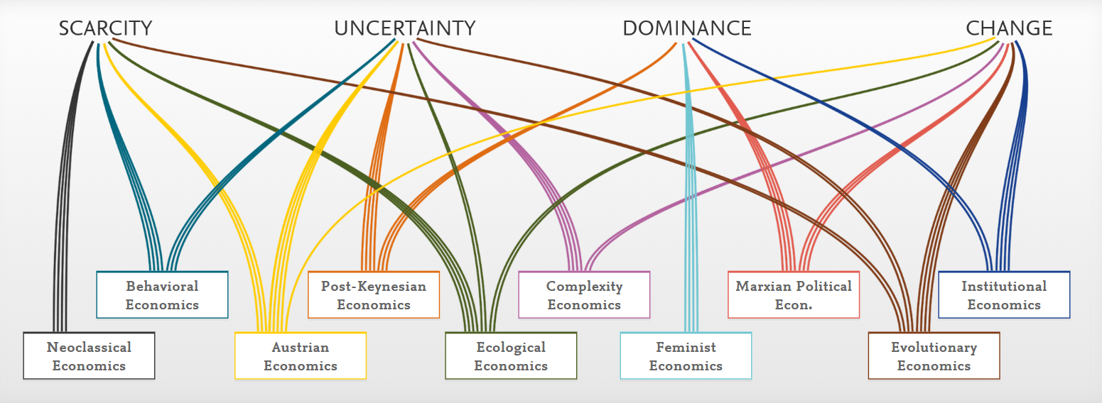

Slide 50
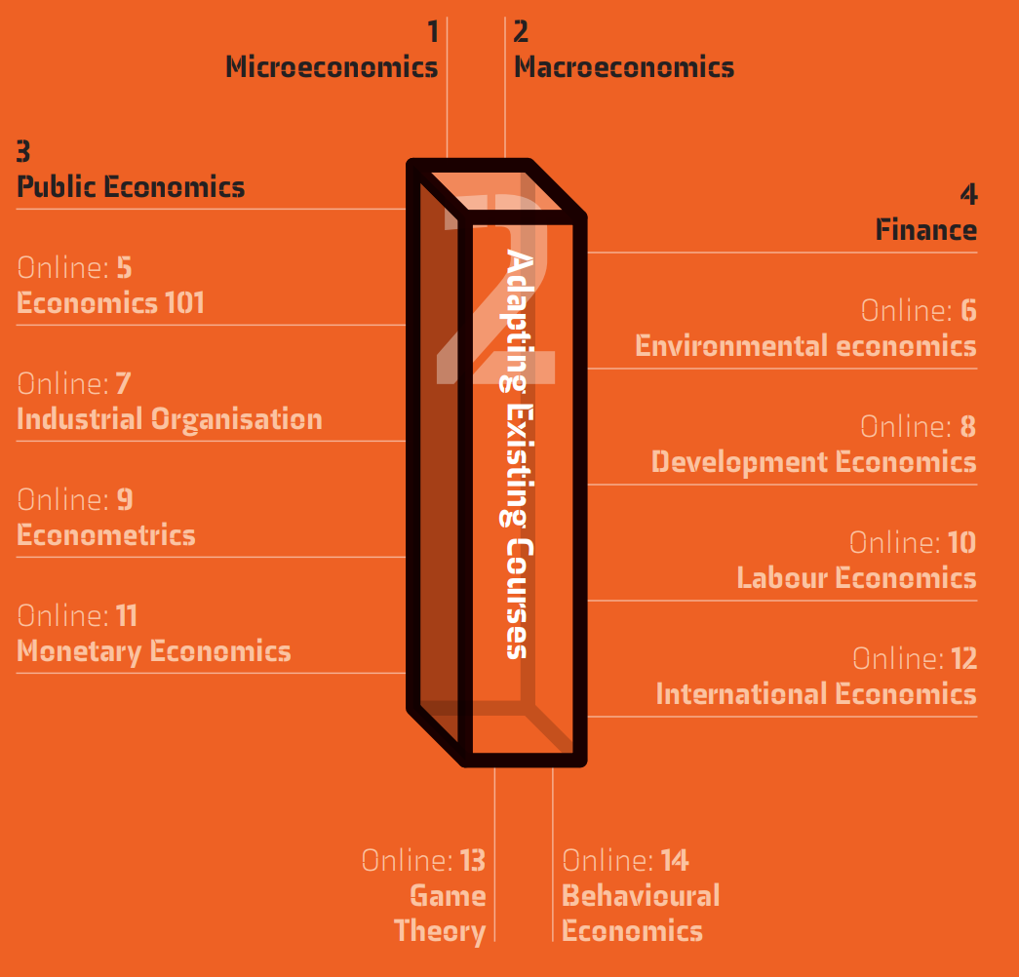

Slide 51
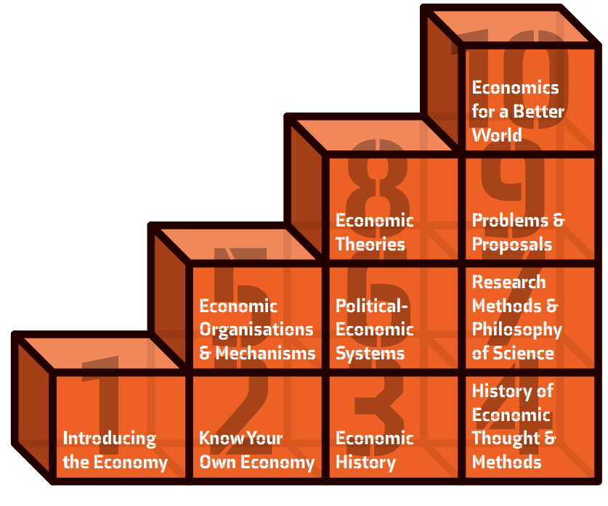
Building Blocks

Slide 52
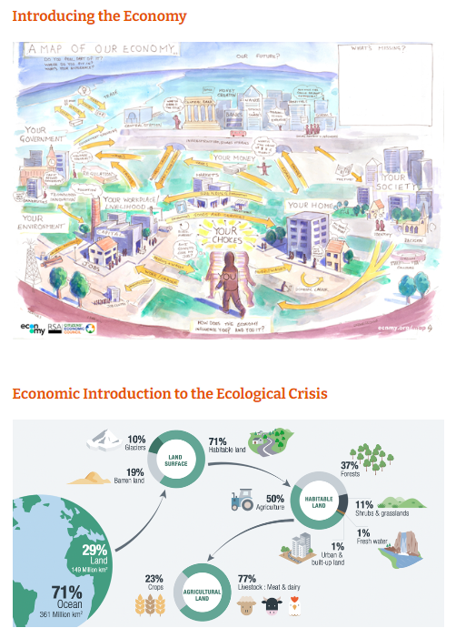
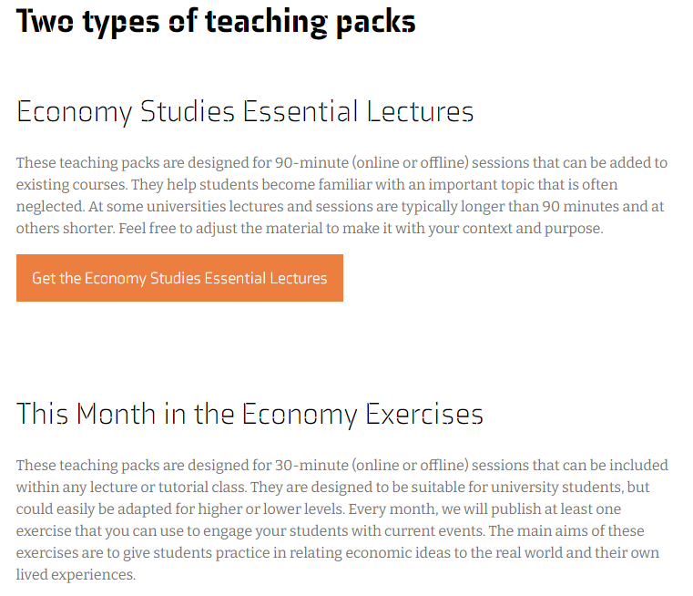

Slide 53
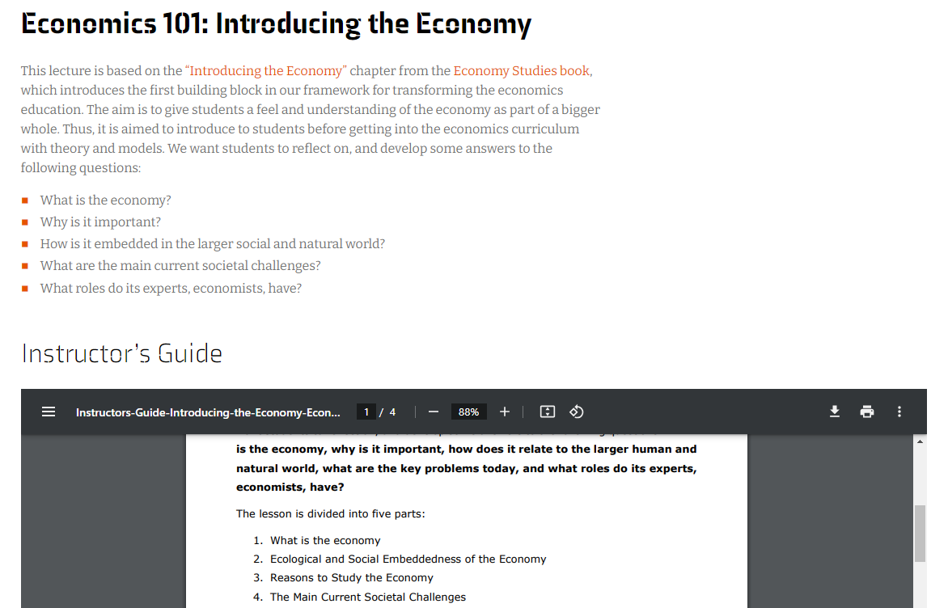

Slide 54
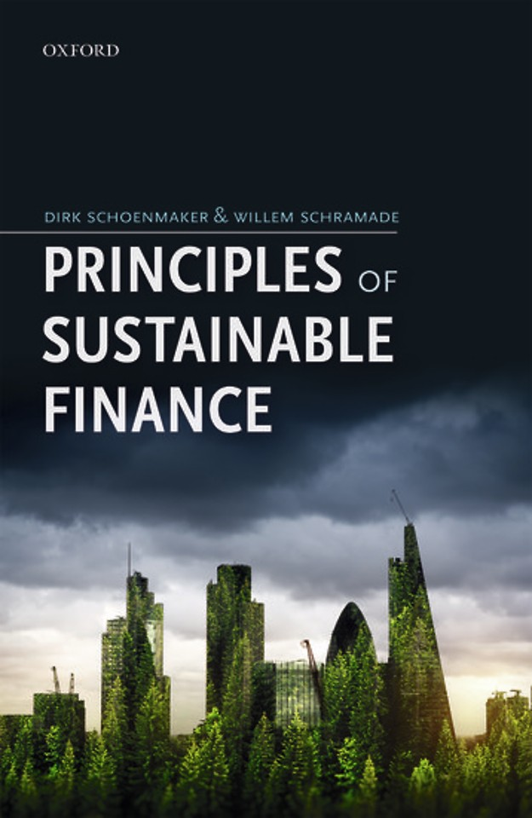
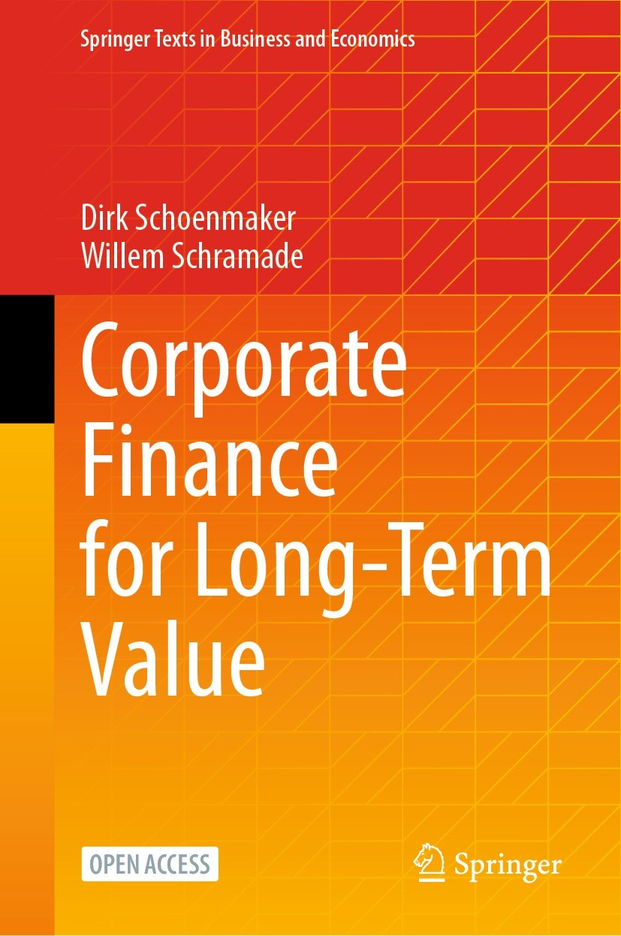
New business textbooks

Slide 56
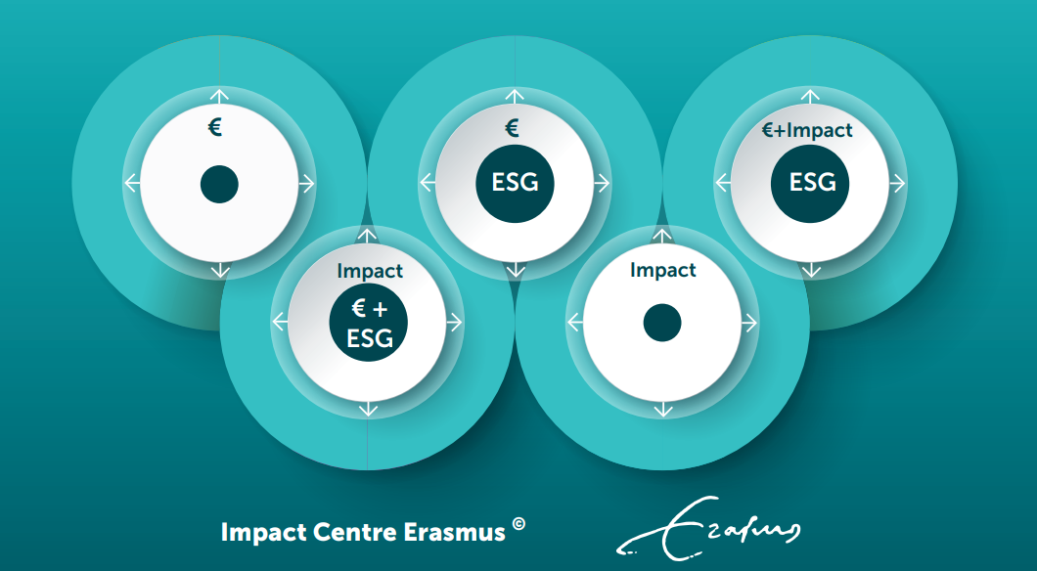
(Maas, 2019)

Slide 58
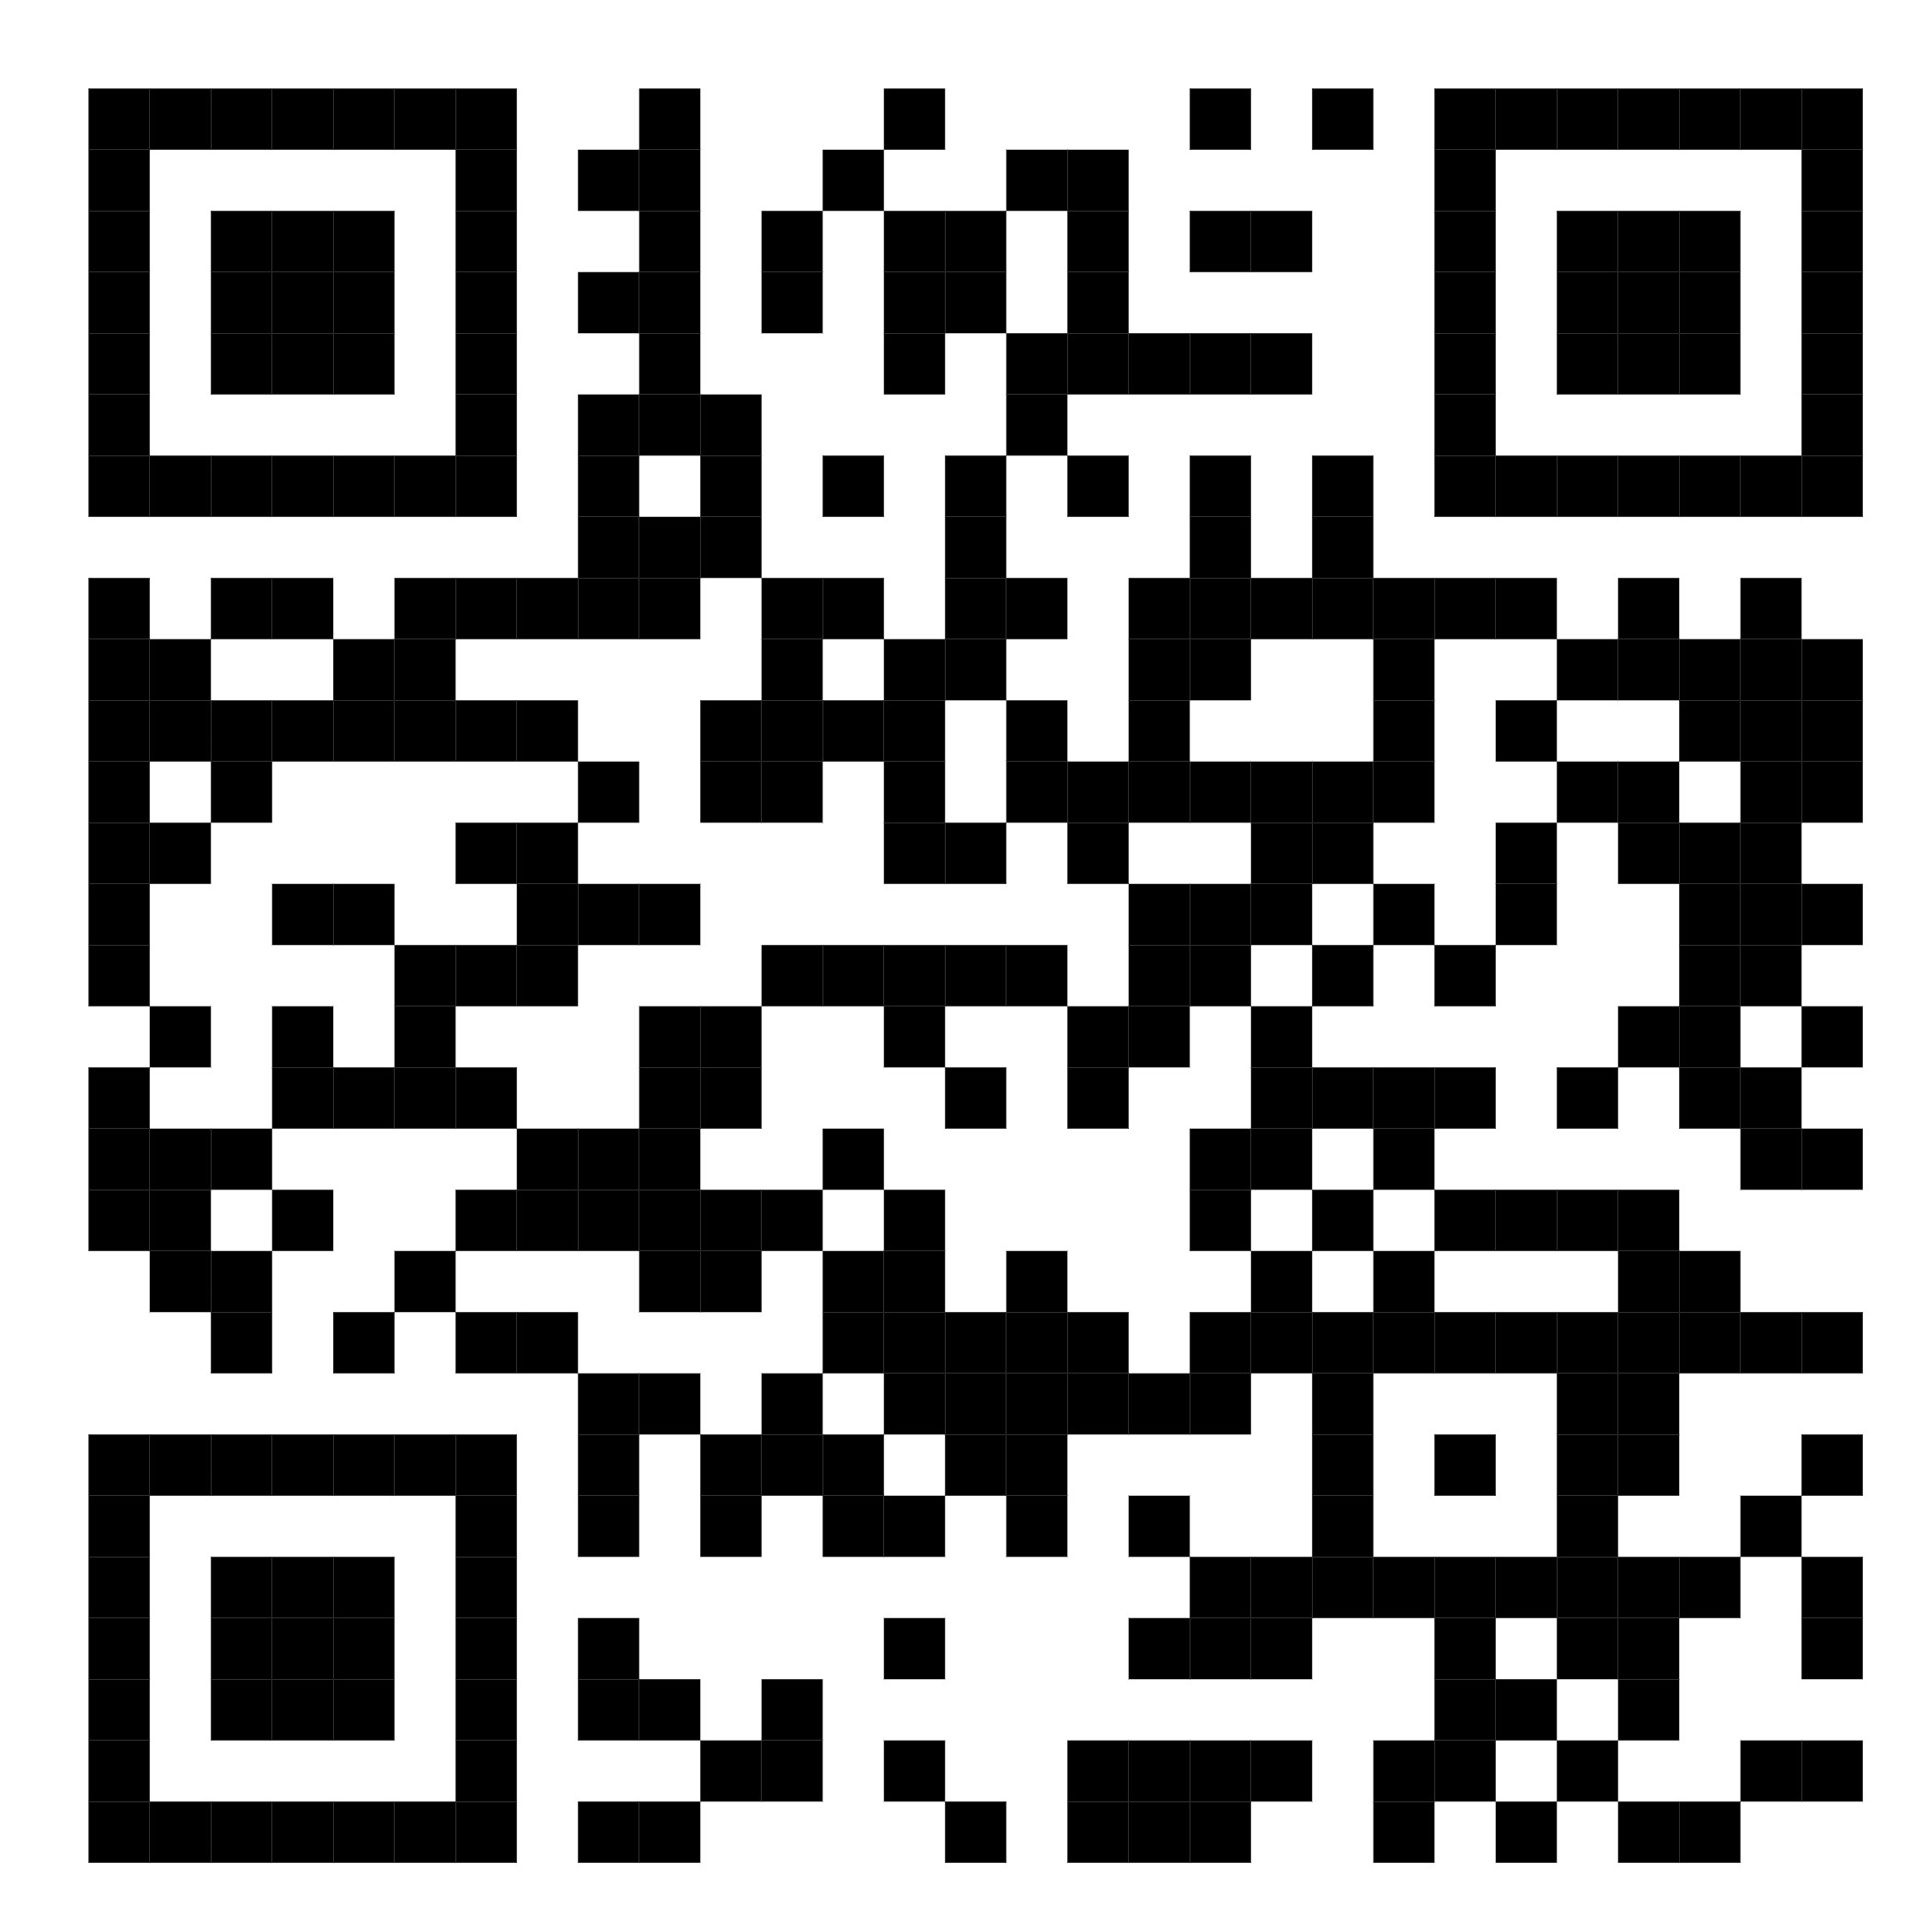
All the Tools for Change on one Page: www.economystudies.com/aeee/

